Slide 1
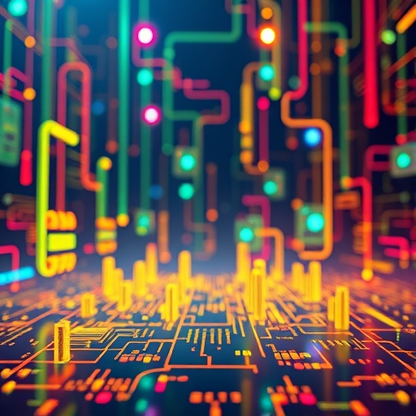
Introduction to Information and Communication Technology Skills
Empowering the Digital Age
Presented by: Kanishk K.R, Navaneeth
Class IX - B

Slide 2

Introduction to ICT
ICT refers to the tools and technologies used to manage, process, and share information. It includes devices like computers, smartphones, and the internet, enabling global communication and information access.
Key Points:
Digital Nature: Information is stored and transmitted in binary format (0s and 1s).
Common Uses: Social media, online banking, e-commerce, and education.
Applications: Healthcare (telemedicine), retail (online shopping), and entertainment (streaming).
ICT enhances communication, improves efficiency, and provides access to vast information.

Slide 3

ICT Devices
Smartphones and tablets are essential ICT tools for daily activities like sending emails, messages, and sharing pictures. They allow people to stay connected via social media and express ideas globally. Smartphones, more advanced than regular mobile phones, support functions like browsing the web, video calls, gaming, and media streaming, using wireless networks (e.g., Android, iOS).
Tablets, larger than smartphones, combine input, output, and processing in one touchscreen, making them ideal for extended reading and other tasks.
TV and radio, long used for broadcasting, remain important ICT tools for entertainment and information. Smartphones and tablets perform various functions with the help of apps, which can be downloaded from stores like Google Play or Apple App Store.

Slide 4
Importance of ICT
• Personal Use: Social media, online banking, and entertainment.
• Workplace: Data analysis, digital communication, and task management.
• Real-life Applications: Online ticket booking, e-banking.

Slide 5
ICT Tools at Work
• Tools: Text editors, spreadsheets, email, and cloud storage.
• Benefits: Enhances productivity, simplifies communication, and streamlines workflows.

Slide 6
Computer Hardware and Software
A computer system has two main parts: hardware (the physical components like the keyboard, monitor, and CPU) and software (programs that make the hardware work, such as the operating system).
Hardware: Devices like the monitor display information.
Software: Programs like the Operating System (OS) (e.g., Windows, Ubuntu, macOS) control the hardware's functionality.
When you start a computer, it runs BIOS to check the system, then loads the OS. Login ensures only authorized users can access their files and applications.
Keyboard and Mouse Usage.
Keyboard: Used for typing commands and text.
Function keys (F1-F12) perform specific tasks.
Control keys like CTRL and SHIFT perform special functions.
Enter key moves the cursor to the next line.
Mouse: Used to select and open items.
Point and click: Select items.
Drag and drop: Move items to new locations.
Double-click: Open files

Slide 7
Operating System
An Operating System (OS) is software that manages computer hardware and software, enabling other programs to run. It acts as an intermediary between the user and the computer hardware.
Key Functions of an OS:
Process Management: Manages running programs and processes.
Memory Management: Allocates memory for tasks and ensures efficient use.
File Management: Organizes and controls access to data stored on the computer.
Device Management: Controls input/output devices like printers, keyboards, and monitors.
Security: Protects data and controls access with login credentials and permissions.
Common Operating Systems:
Windows: Popular for personal computers and businesses.
macOS: Used on Apple computers, known for its sleek design.
Linux/Ubuntu: Open-source OS, often used by developers and for servers.
Android/iOS: Operating systems for smartphones and tablets.

Slide 8
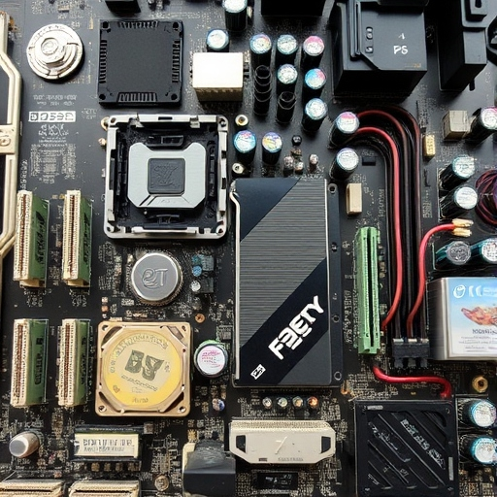
Parts of a Computer
- 1. Central Processing Unit (CPU)
Function: The brain of the computer. It performs calculations, processes instructions, and manages tasks.
Components:
Control Unit (CU): Directs the operation of the processor.
Arithmetic and Logic Unit (ALU): Performs arithmetic and logical operations.
Memory Unit (MU): Stores data temporarily for processing.
2. Input Devices
Allow users to input data into the computer.
Keyboard: Used to type text and commands.
Mouse: Used to move the pointer and select items on the screen.
Scanner: Converts physical documents into digital format.

Slide 9
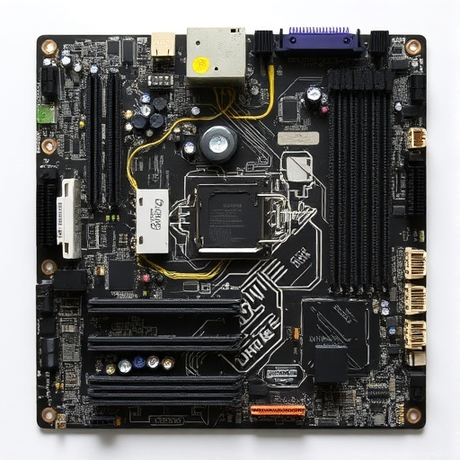
3. Output Devices
Function: Display the results of processed data.
Examples:
Monitor: Displays visual output from the CPU.
Printer: Produces a hard copy of digital data.
Speakers: Produce audio output.
4. Storage Devices
Function: Store data and programs.
Examples:
Hard Drive (HDD): Primary storage for operating systems, software, and files.
Solid-State Drive (SSD): Faster storage alternative to HDD.
USB Flash Drive: Portable storage for transferring files.

Slide 10

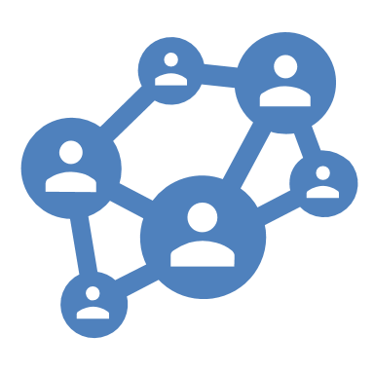
Internet and Communication
• The Internet: A global network enabling access to information and communication.
• Uses: E-commerce, online education, social networking, and email.

Slide 11

Skills for Effective ICT Use
• Key Skills: Operating systems, basic file management, and internet browsing.
• Emerging Skills: Cloud computing, data analysis, and digital security awareness.

Slide 12
Conclusion
• Summary: ICT is integral to modern life, enabling efficient communication and information access.
• Call to Action: Embrace ICT to stay ahead in the digital world.

